Slide 1

4
Telecommunications
and Networking

Slide 2
Learning Objectives
What is a computer network?
Compare and contrast the major types of networks.
Describe major communications media and transmission technologies.
Describe common methods for accessing the Internet.
Explain network applications of discovery, collaboration, communication, and education.

Slide 3



What to Do about Landline Telephones?
  Should the large carriers be able to eliminate their plain old telephone systems (POTS) networks?
    Debate this argument from the viewpoint of the large telecommunications carriers.
    Debate this argument from the viewpoint of customers.
  Why are wireless networks unable to take over all of the functions of POTS networks?
  (Tips: Cost; profit; public safety alarm systems; FCC – universal service guarantee; etc.)

Slide 4
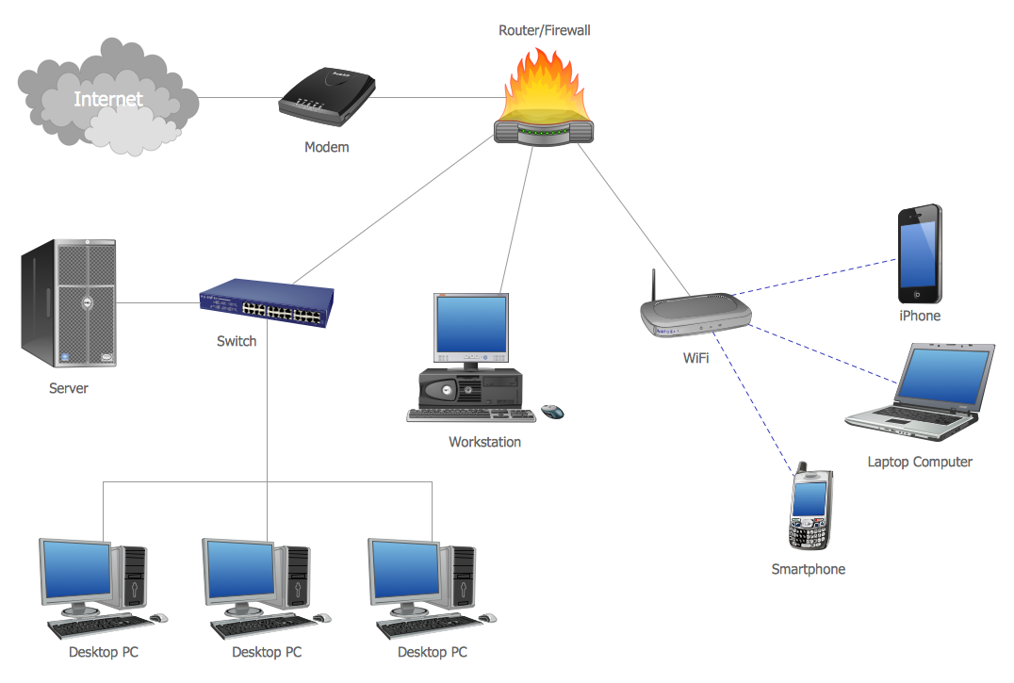
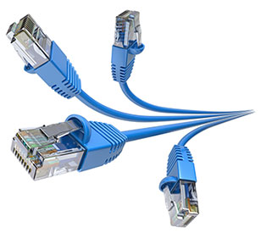
Computer Network
Bandwidth: the transmission capacity of a network in bits per second (bps).
A system that,
Connects computers and other devices
via communications media
Data and information can be transmitted among them
2 measures:
  Bandwidth
  Broadband
Broadband: The transmission capacity of a communications medium

Slide 5
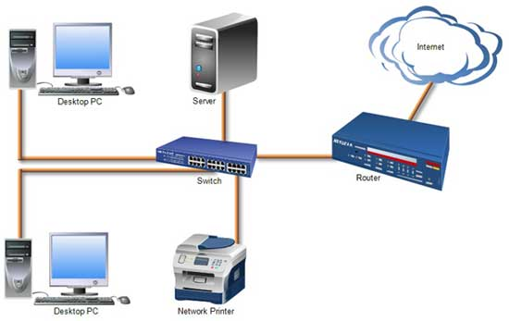
Computer Network
Local Area Network (LAN):
Connects two or more devices
Limited geographical region
Limited number of connected devices

Slide 6
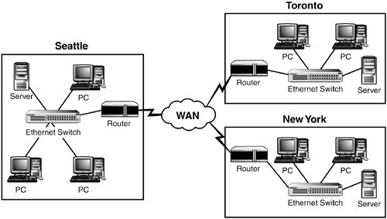
Computer Network
Wide Area Network (WAN):
Covers a large geographical area.
Connect multiple LANs.
Combine multiple media channels (e.g., fiber-optic cables, microwave, and satellite).
Have large transmission capacity.

Slide 7
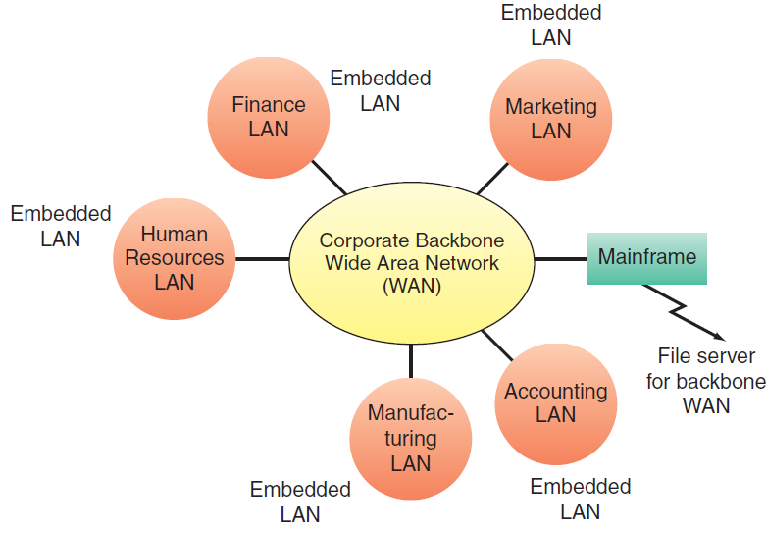
Computer Network
Enterprise Network:
Corporate backbone network.
Organizational interconnected network.
High speed network with multiple smaller functional networks (e.g., LANs and WANs.

Slide 8


Network Fundamentals
Binary Form
This is REAL You!
This is DIGITAL You!

Slide 9
Network Fundamentals
Digital signals:
Transmitted in binary form
Over communications media and channels
Follow network protocols

Slide 10
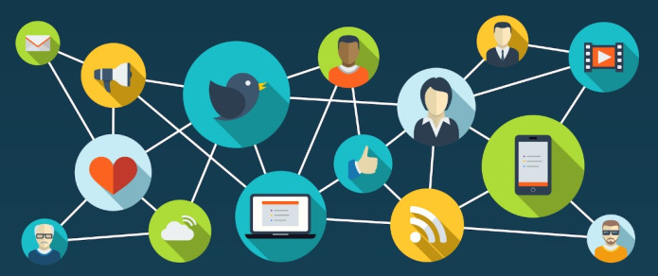
Communications Media & Channels
Communication Channel: a pathway or medium communicating data from one location to another.
Communication Media: physical media used to send data
Twisted-Pair Wire
Coaxial Cable
Fiber Optics
Satellite
Cable vs. DSL (Digital Subscriber Line): https://www.youtube.com/watch?v=VAHAFi0TsbE&feature=youtu.be

Slide 11
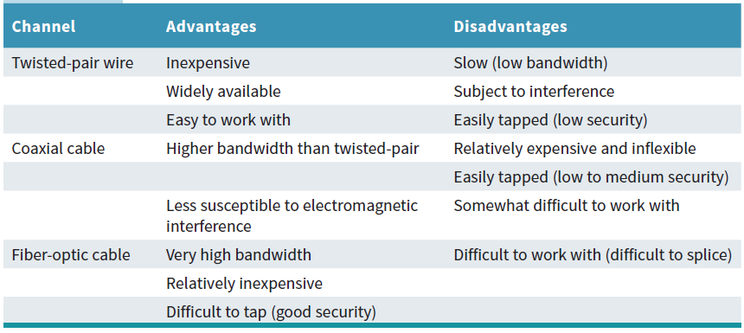
Advantages and Disadvantages of Wireline Communications Channels

Slide 12
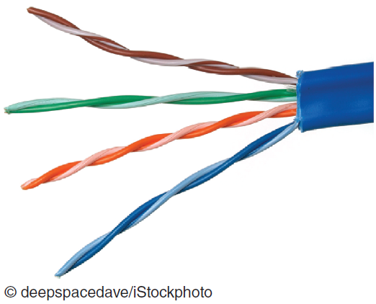
Communications Media:
Twisted-Pair Wire
The most prevalent form of communications for almost all business telephone wiring
Consists of strands of copper wire twisted in pairs.
Relatively inexpensive
Widely available
Easy to work with.

Slide 13
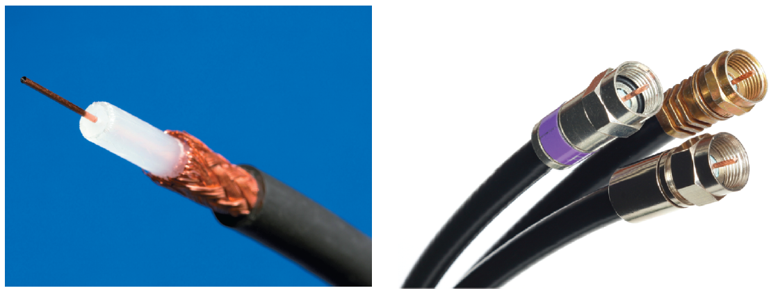
Coaxial Cable
A single strand of insulated copper wire.
Less susceptible to electrical interference
Carry more data
Carry high-speed data traffic as well as television signals.

Slide 14
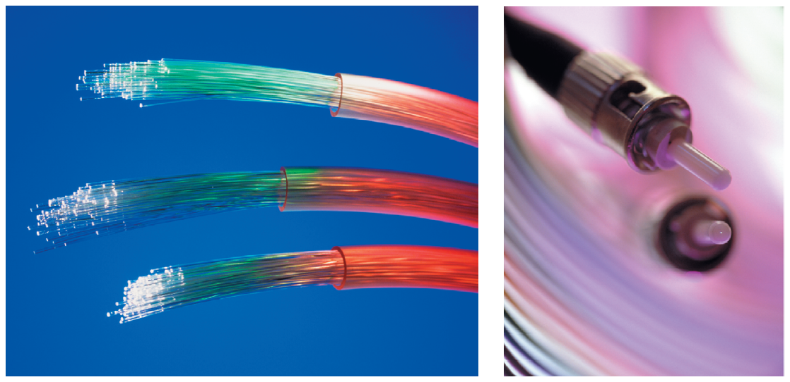
Fiber Optics
Consists of thin filaments of glass fibers.
Transmit information via light pulses.
Surrounded by cladding.
Prevents light from leaking out of the fiber.

Slide 15
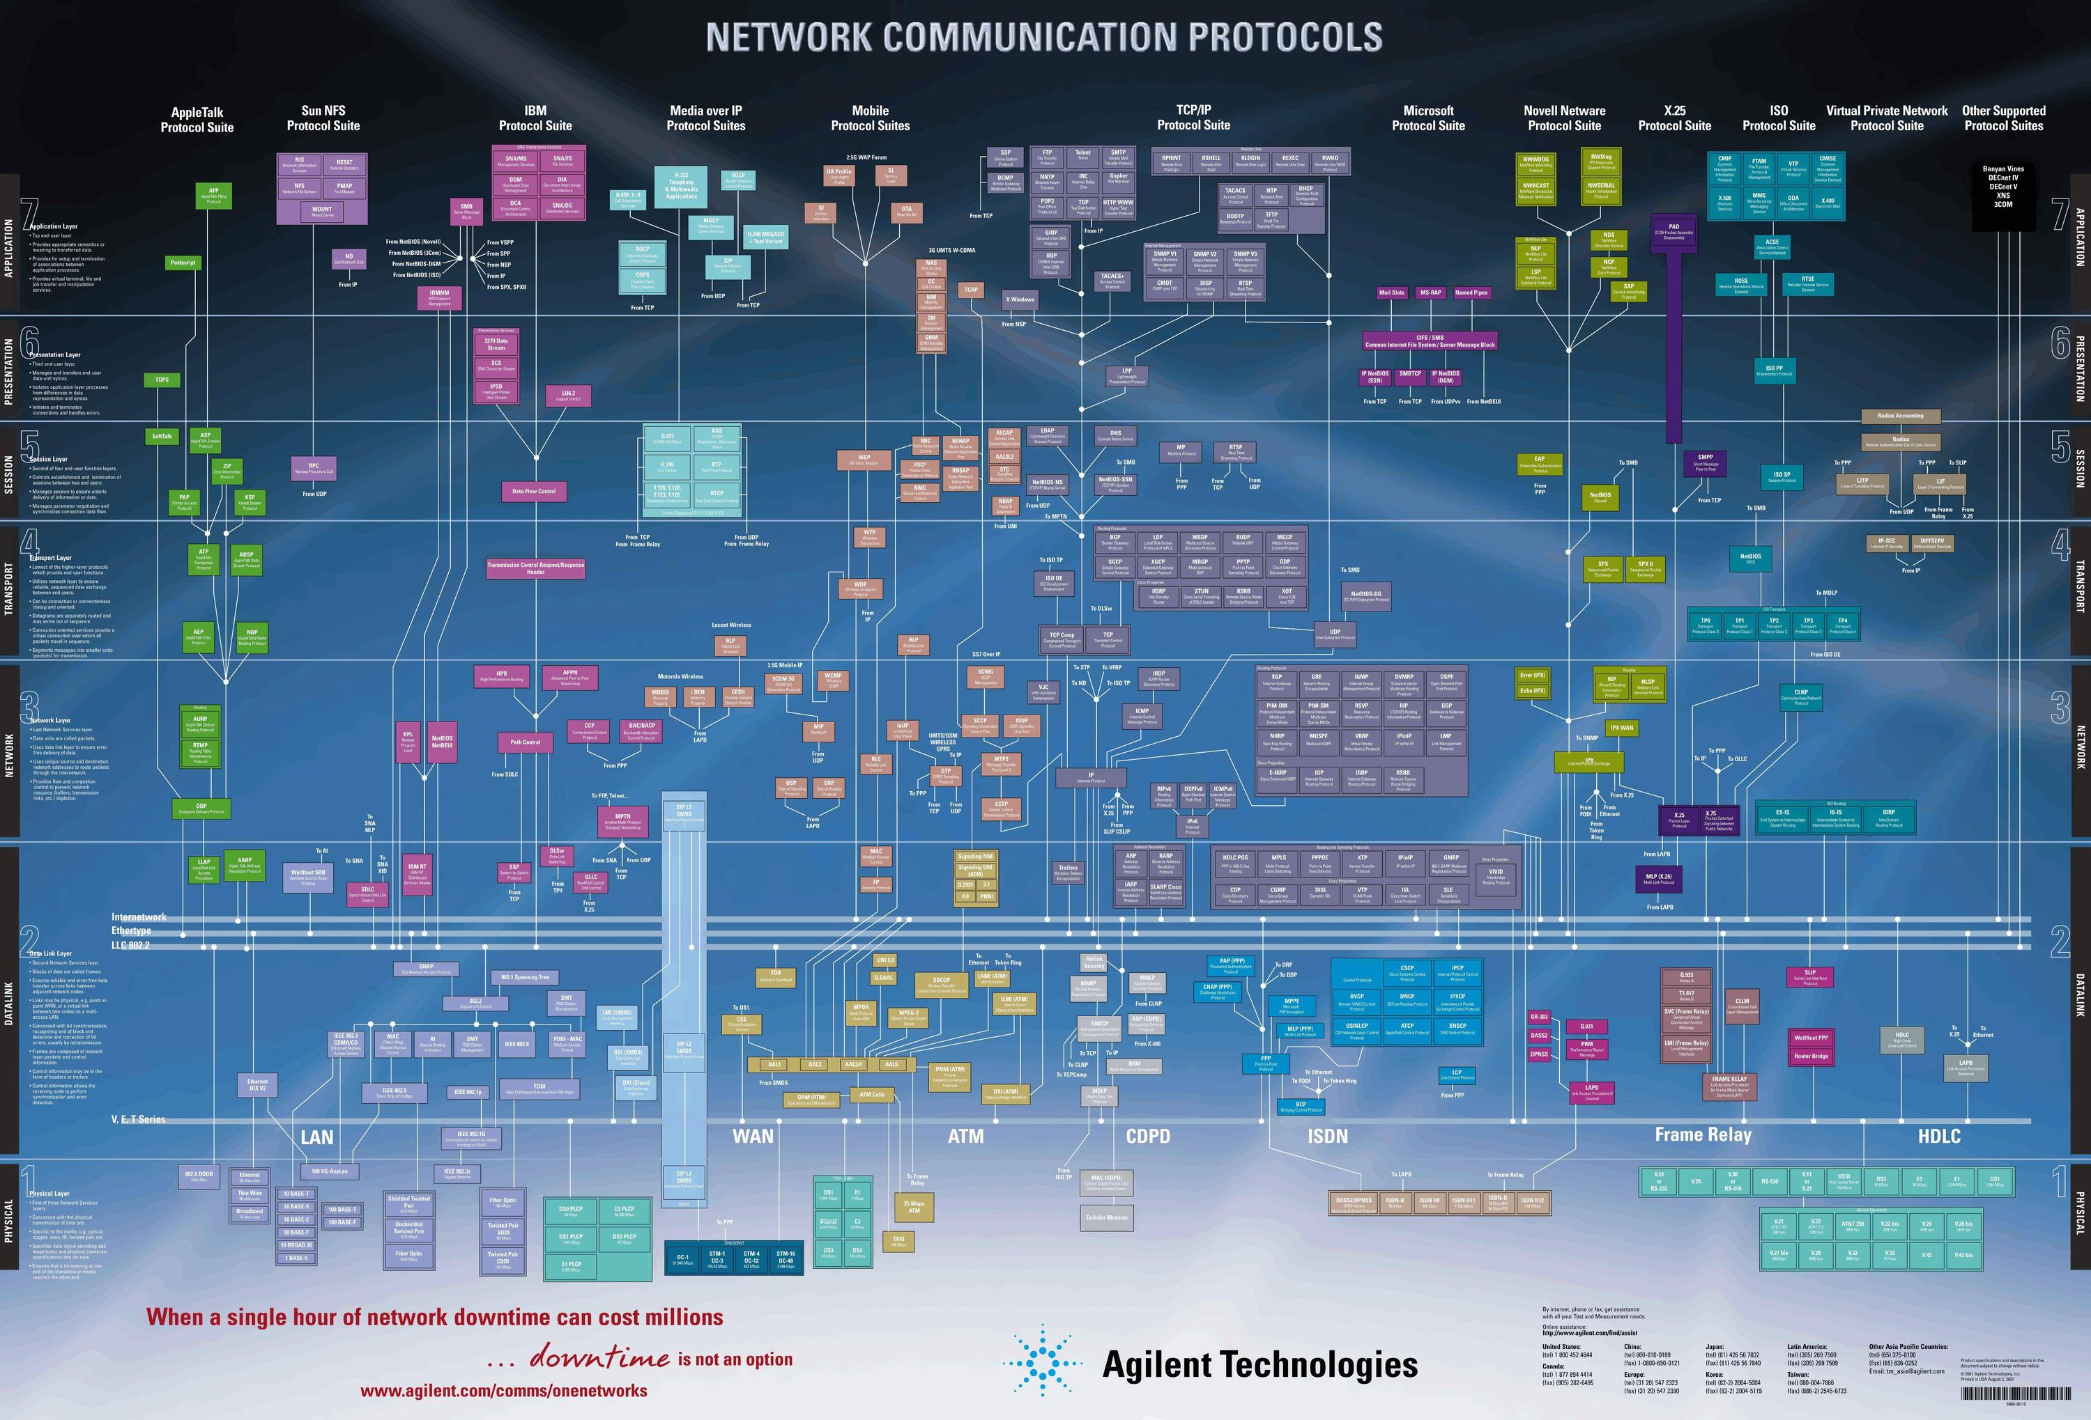
Network Protocols
A set of rules and procedures that enable nodes on a network to communicate with one another.
Ethernet: A commonly used LAN protocol.
Transmission Control Protocol / Internet Protocol (TCP/IP)

Slide 16
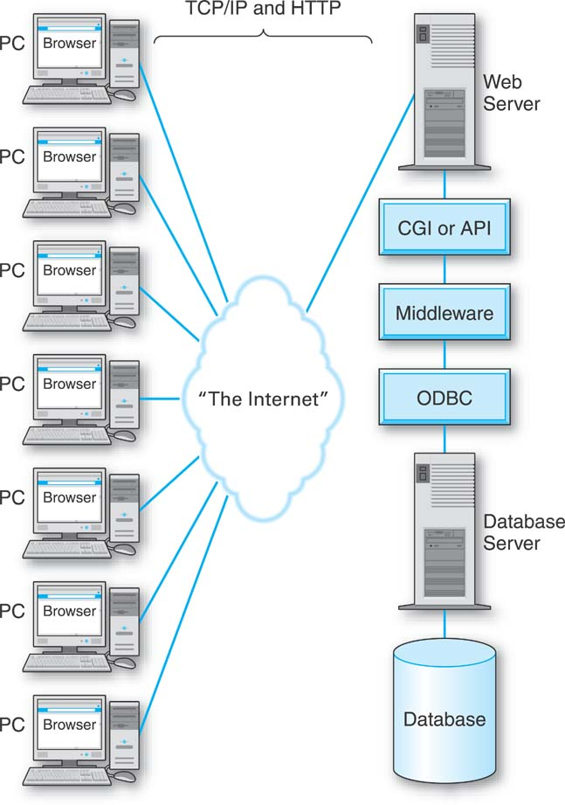
Network Connectivity: Protocols
The Internet communications follow Transmission Control Protocol/Internet Protocol (TCP/IP) and Hypertext Transfer Protocol (HTTP) .
All Internet traffics follow the rules of TCP/IP and HTTP.

Slide 17
Basic Functions of the TCP/IP
Manages the movement of data packets between computers.
Manages transmission sequences the packets
Acknowledges the packets transmitted
IP: Responsible for disassembling, delivering and reassembling the data during transmission.

Slide 18
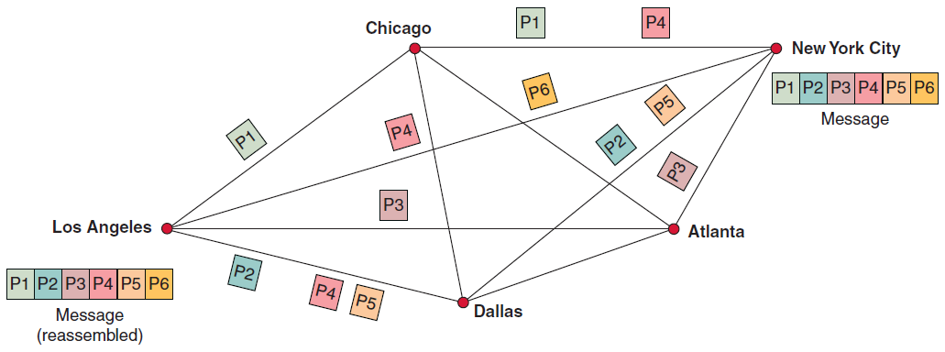
Packet and Packet Switching
Packets:
Data divided into small, fixed pieces
Converted into binary forms
Packet Switching: Transmission technology (https://www.youtube.com/watch?v=vSlcoQowe9I)
Breaks blocks of data into packets.
Packets carry the information that will help it reach its destination—the sender’s IP address, the intended receiver’s IP address, the number of packets in the message, and the number of the particular packet within the message.
Each packet travels independently across the network and can be routed through different paths in the network.
When the packets reach destination, they are reassembled into the original message.

Slide 19
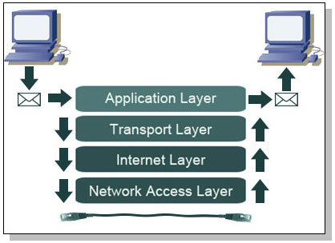
4 Layers of TCP/IP Reference Model
Application Layer: the layer that applications use to exchange data.
Transport Layer: Provides application layer with communication and packet services.
Internet Layer: Addressing, routing, and packaging data packets.
Network Interface Layer: Places packets on, and receives them from, network medium
https://www.youtube.com/watch?v=KEWe-5Bk3Q0

Slide 20
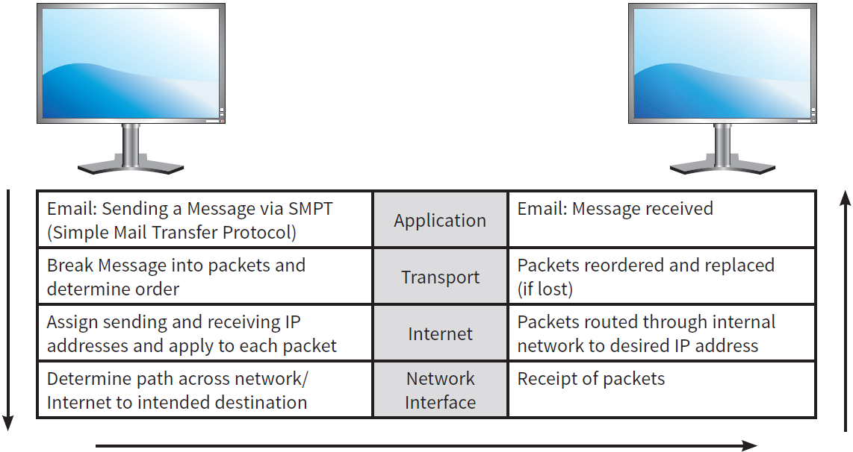
The 4 Layers of the TCP/IP Reference Model

Slide 21
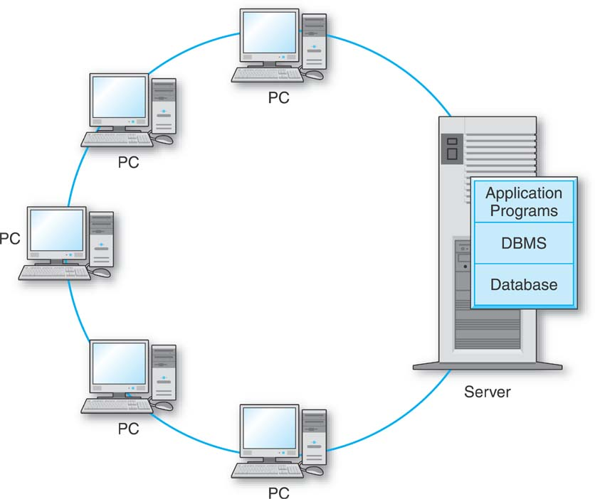
Types of Network Processing:
Client/Server System
Client computer: End-user PCs or any computing devices, connected to a server computer over the Internet; Make requests for and use online services.
Server computer: PCs or mainframe computers with application programs, DBMS, and database shared by all client computing devices.
Notes:
System or architecture
Attaching database to the Internet

Slide 22
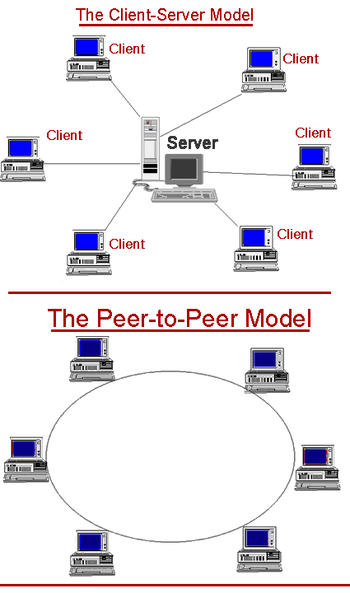
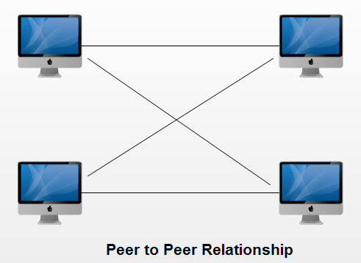
Types of Network Processing:
Peer-to-Peer Processing
A type of client/server distributed processing
Each computer acts as both a client and a server.
Each computer can access all files on all other computers.

Slide 23

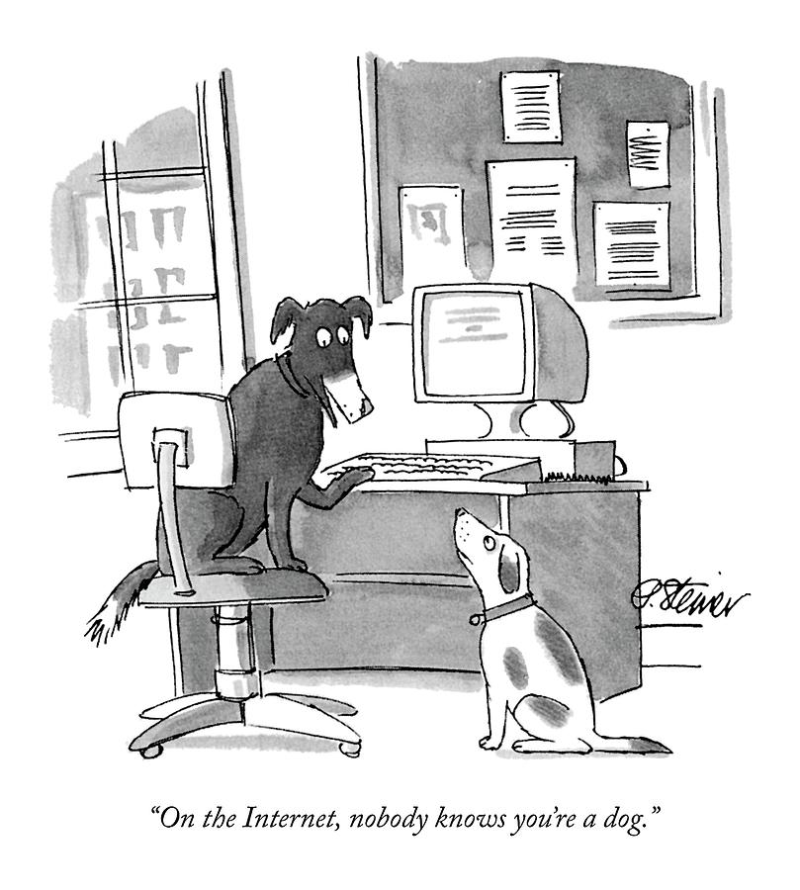
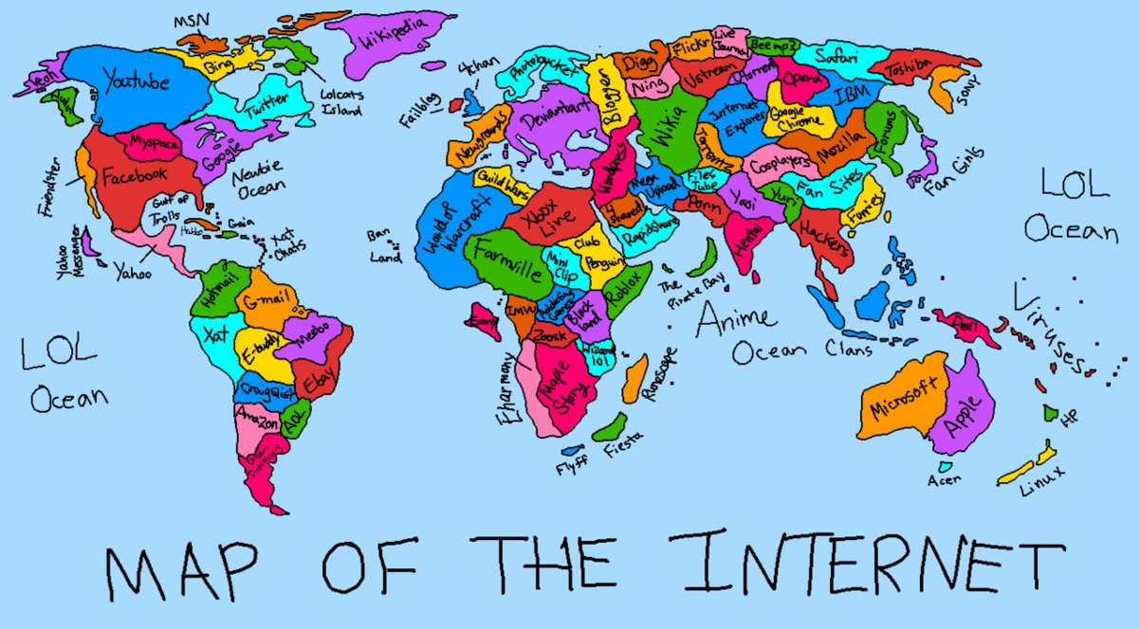
Internet (“the Net”):
A network of networks……
A global WAN.
Internet Backbone: The primary network connections and telecommunications lines that link the nodes of the Internet using a fiber-optic network that is operated primarily by large telecommunications companies or governments.

Slide 24

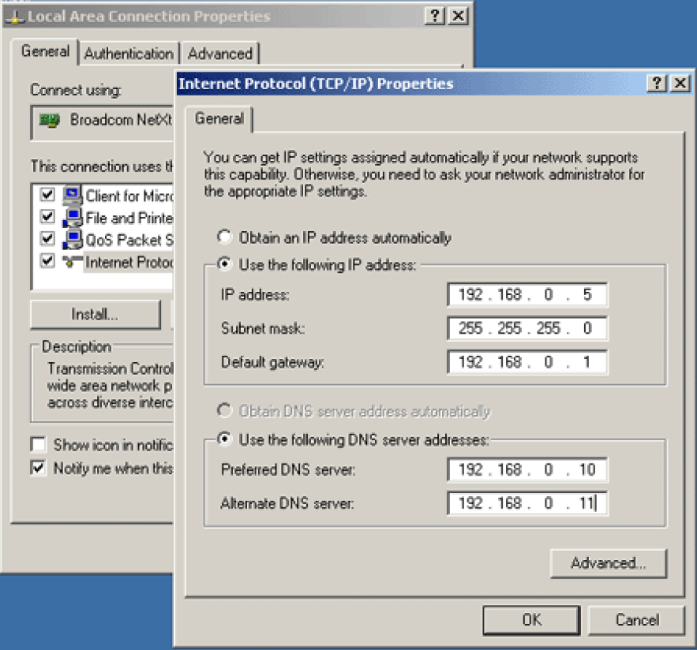
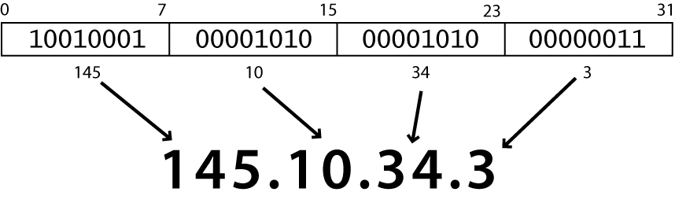

Internet Terminology
Network Access Points (NAPs): Exchange points for Internet traffic; determine how traffic is routed.
Internet Protocol Address
Browser

Slide 25
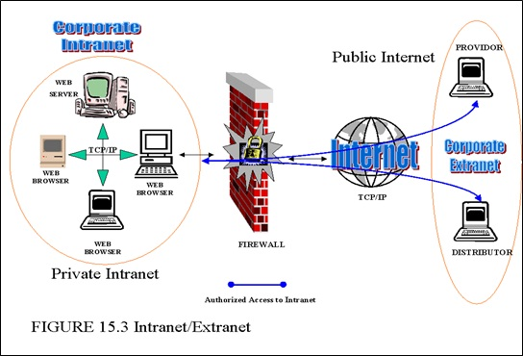
Internet Terminology
Intranet:
A network that uses Internet protocols
For organizational discovery (easy and inexpensive browsing and search), communication, and collaboration
Inside an organization
Extranet:
Connects parts of the intranets of different organizations
Enables business partners to communicate securely over the Internet
Using virtual private networks (VPNs)

Slide 26
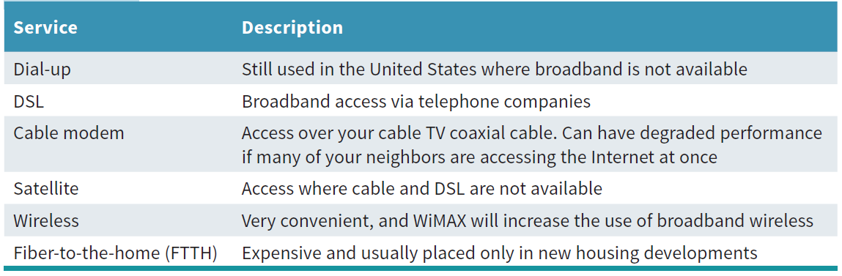


Internet Connection Methods
Internet service provider (ISP): A company that provides Internet connections for a fee.
https://www.youtube.com/watch?v=8HbIh5aeF-U&feature=youtu.be

Slide 27
Future of the Internet
High User Demand: Reduced Performance in the near Future
Internet is unreliable and not secure.
Internet2: Advanced network applications such as remote medical diagnosis, digital libraries, distance education, online simulation, and virtual laboratories.

Slide 28



The World Wide Web (WWW)
World Wide Web: A system of universally accepted standards for storing, retrieving, formatting, and displaying information via a client/server architecture.
Hypertext: Text displayed on a computer display or other electronic device with references, called hyperlinks, to other text that the reader can immediately access, or where text can be revealed progressively at additional levels of details.
URL (Uniform Resource Locator): The address of a specific resource on the Web.

Slide 29
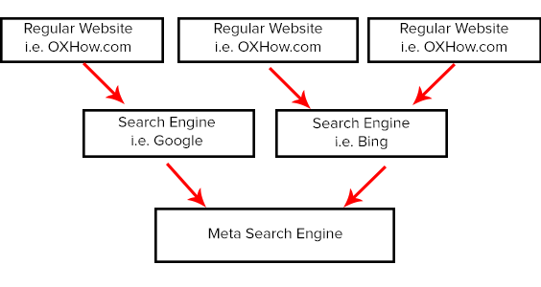
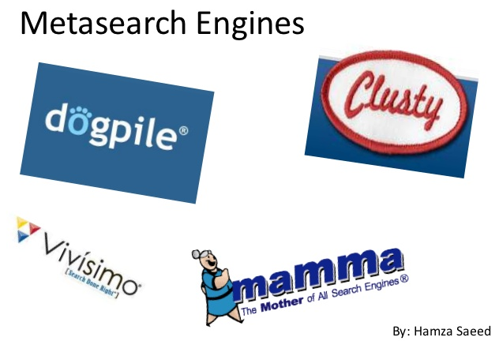
Network Applications: Discovery
Search Engines
Metasearch Engines: Search several engines at once and then integrate the findings to answer users’ queries.
Portals: A Web-based, personalized gateway to information and knowledge that provides relevant information from different IT systems and the Internet using advanced search and indexing techniques.

Slide 30

Network Applications: Communication
Electronic Mail
Web-Based Call Centers
Electronic Chat Rooms
Voice Communication
  VoIP
Unified Communications
Telecommuting

Slide 31
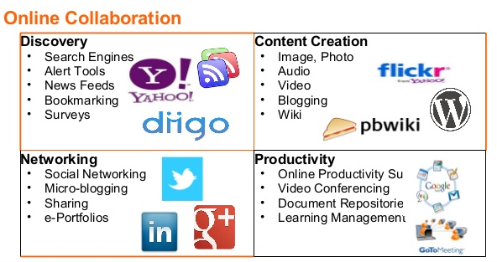


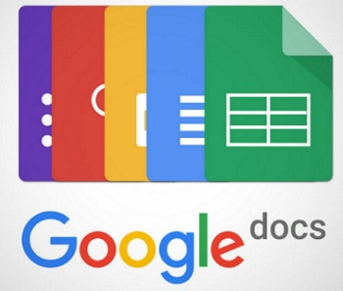

Network Applications: Collaboration
Workgroup
Virtual Group (Team)
Virtual Collaboration
Electronic Teleconferencing
Video Conferencing

Slide 32

Network Applications: Education
E-Learning
Distance Education
Virtual Universities
Impact of education network application on business and everyday life.

Slide 33
Summary
What is a computer network?
Compare and contrast the major types of networks.
Describe major communications media and transmission technologies.
Describe common methods for accessing the Internet.
Explain network applications of discovery, collaboration, communication, and education.

